Slide 1


LETTER FREQUENCY ANALYSIS THROUGH HADOOP
Martina Fabiani
Rossana Antonella Sacco
Tommaso Falaschi

Slide 2
LETTER FREQUENCY ANALYSIS THROUGH HADOOP
LETTER FREQUENCY
Two different hadoop design patterns:
Combiner
InMapping Combining
PERFOMANCE ANALYSIS
MapReduce alghoritm execudes with different configuration.
STATISTIC ANALYSIS
Analysis of letter frequency in diffent leanguages, similarites and differences

Slide 3
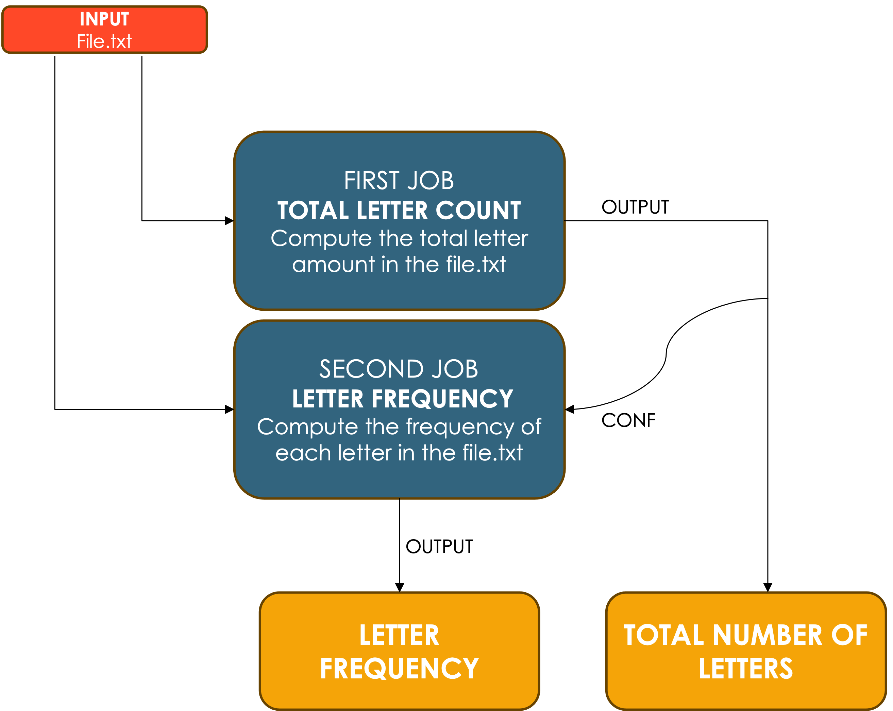
GENERAL WORKFLOW

Slide 4
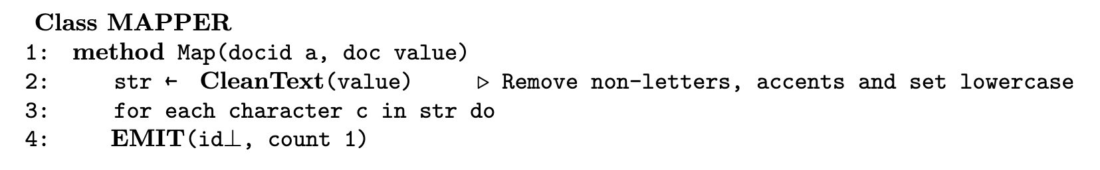
COMBINER
TOTAL LETTER COUNT
MAPPER

Slide 5
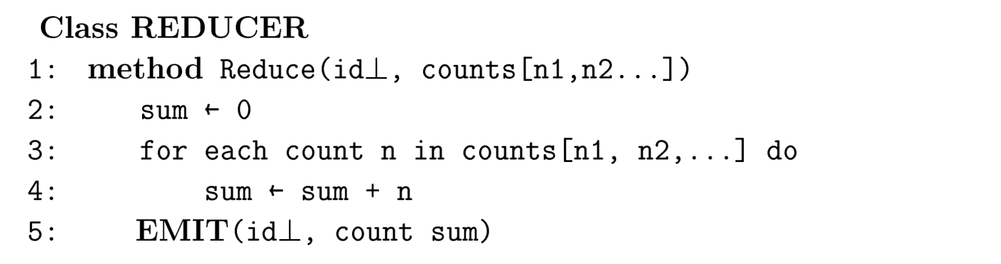
COMBINER
TOTAL LETTER COUNT
REDUCER

Slide 6
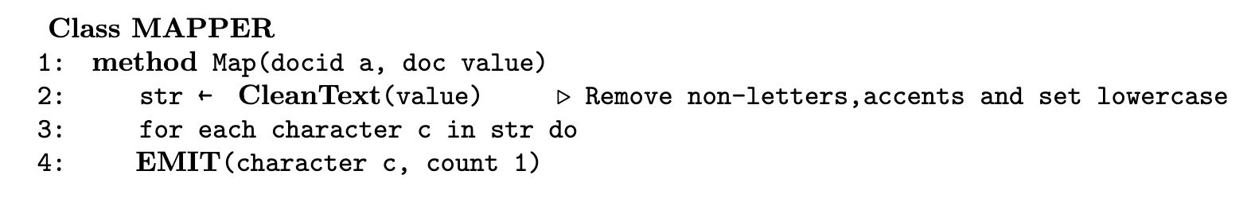
COMBINER
LETTER FREQUENCY
MAPPER

Slide 7
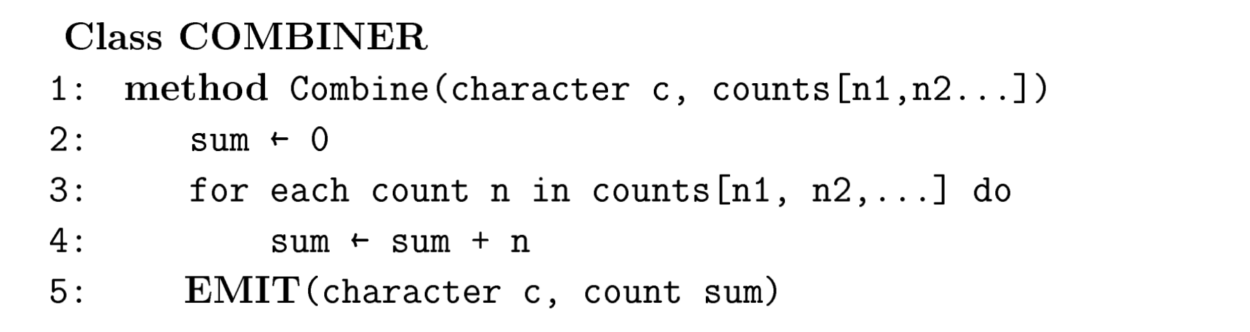
COMBINER
LETTER FREQUENCY
COMBINER

Slide 8
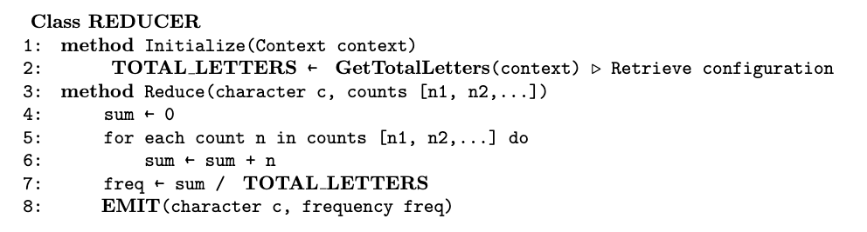
COMBINER
LETTER FREQUENCY
REDUCER

Slide 9
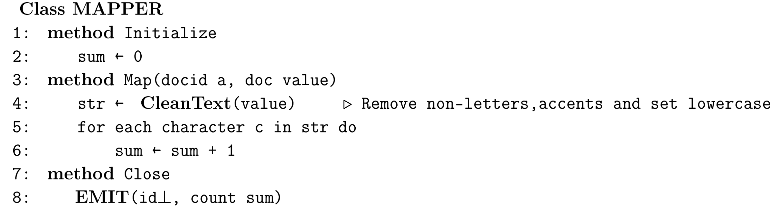
INMAPPING COMBINING
TOTAL LETTER COUNT
MAPPER

Slide 10
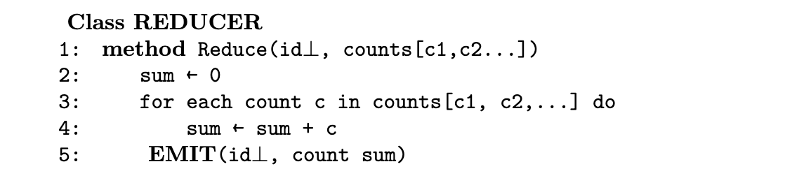
INMAPPING COMBINING
TOTAL LETTER COUNT
REDUCER

Slide 11
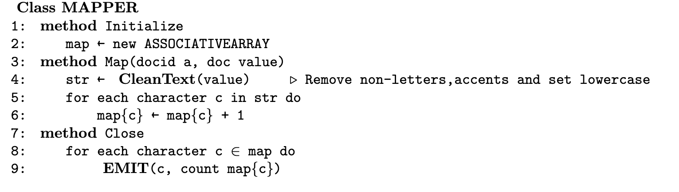
INMAPPING COMBINING
LETTER FREQUENCY
MAPPER

Slide 12
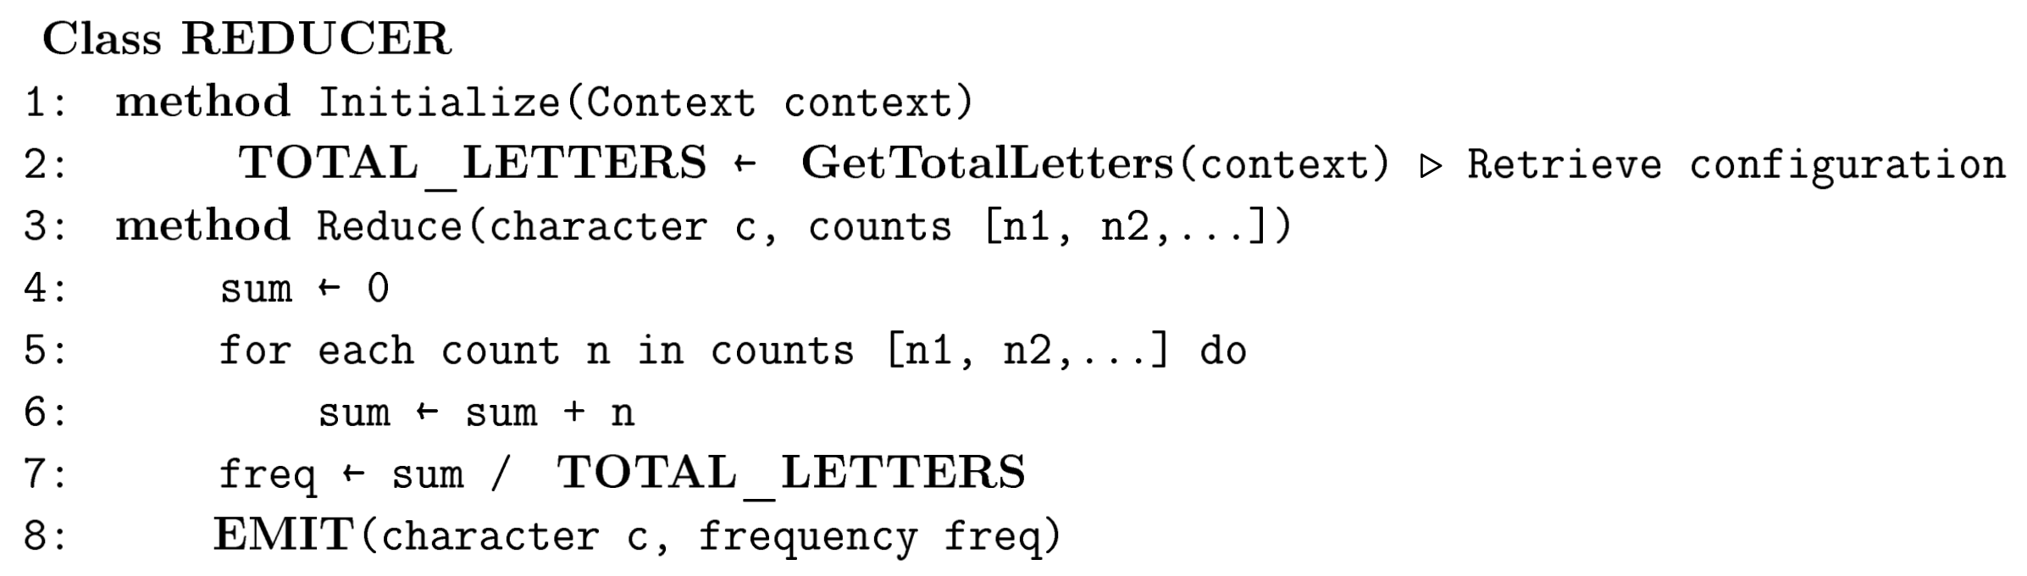
INMAPPING COMBINING
TOTAL LETTER COUNT
REDUCER

Slide 13
PERFORMANCE ANALYSIS
DIFFERENT NUMBER OF REDUCERS
DIFFERENT DATA SIZES
DIFFERENT DESIGNS
COMBINER
INMAPPING COMBINING
2.09 KB
2.14 MB
2.15 GB
FROM 1 TO 3 REDUCERS

Slide 14
PERFORMANCE ANALYSIS
PARAMETER CONSIDERED
Total time spent by all MAP tasks
Total time spent by all REDUCE tasks
CPU time spent
Garbage Collection (GC) time elapsed
Reduce shuffle bytes
Physical memory (bytes) snapshot
(ms)

Slide 15
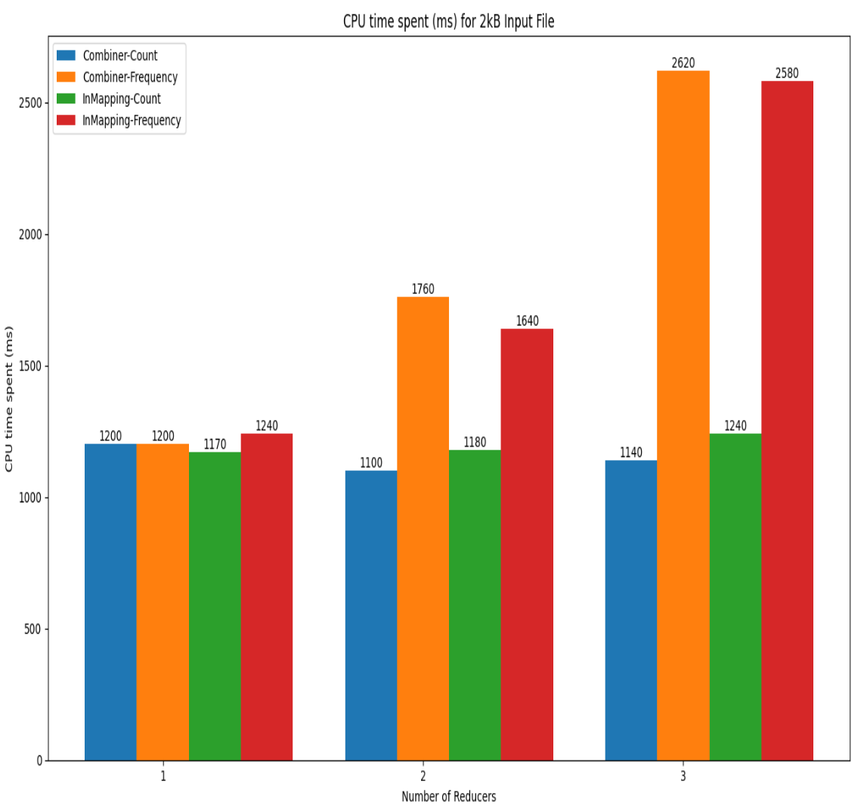
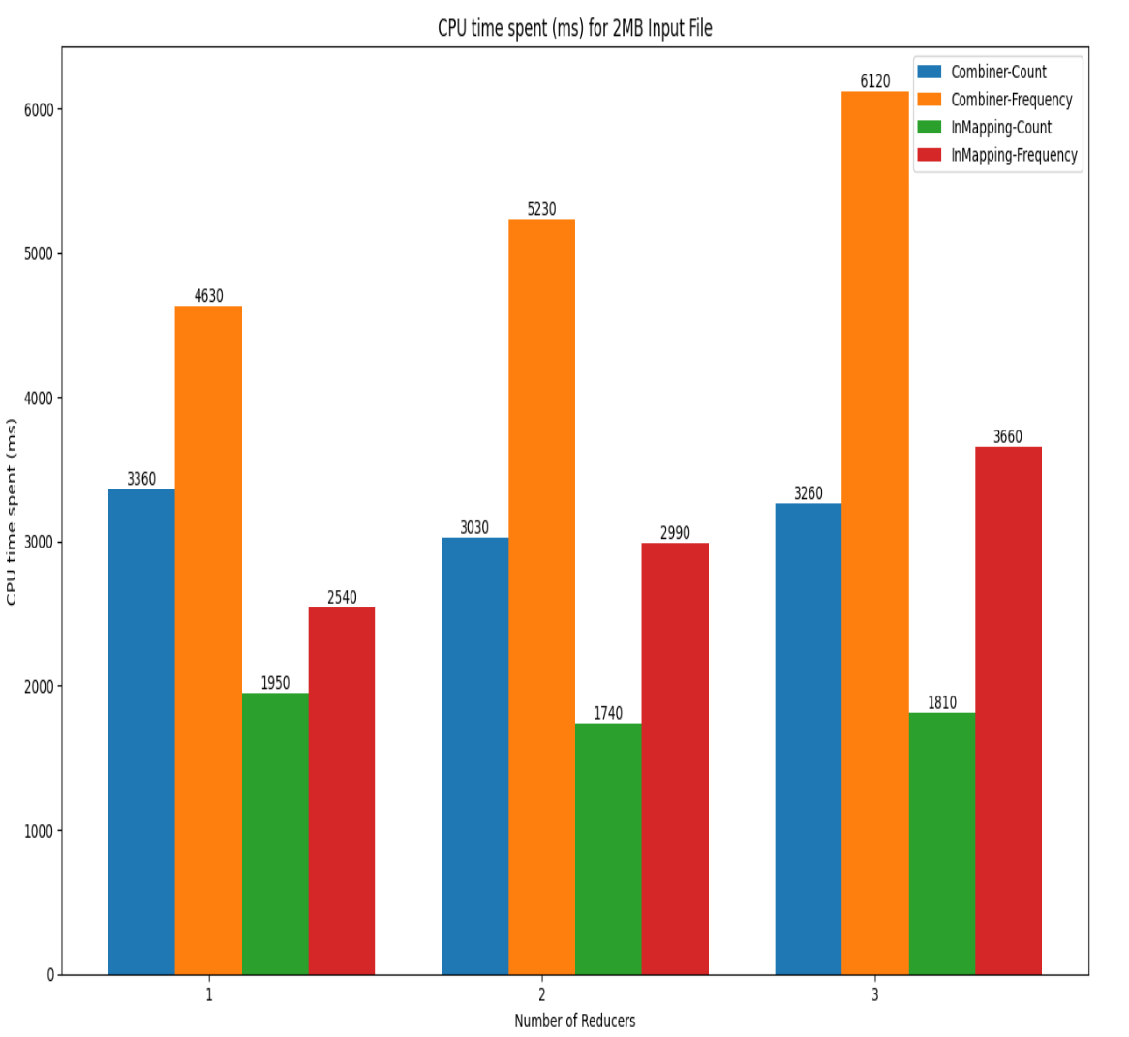
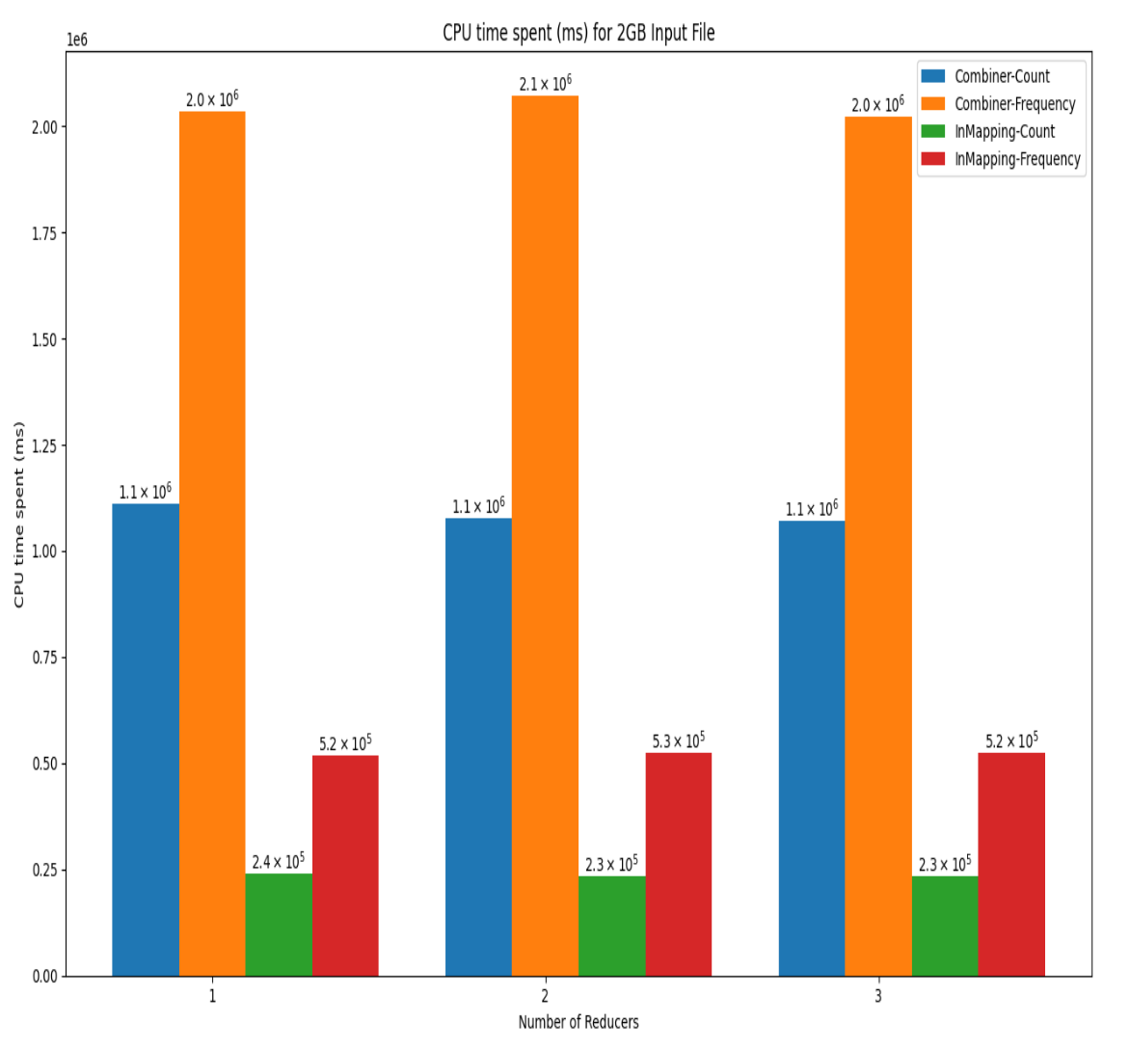
PERFORMANCE ANALYSIS
MAIN RESULTS

Slide 16
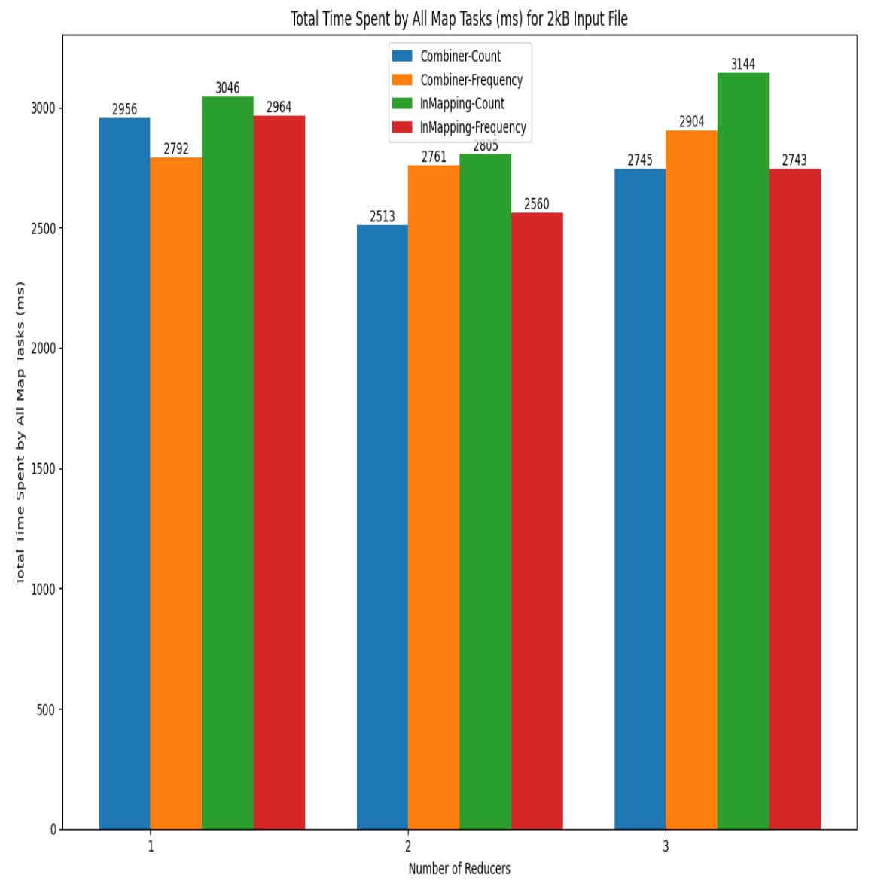
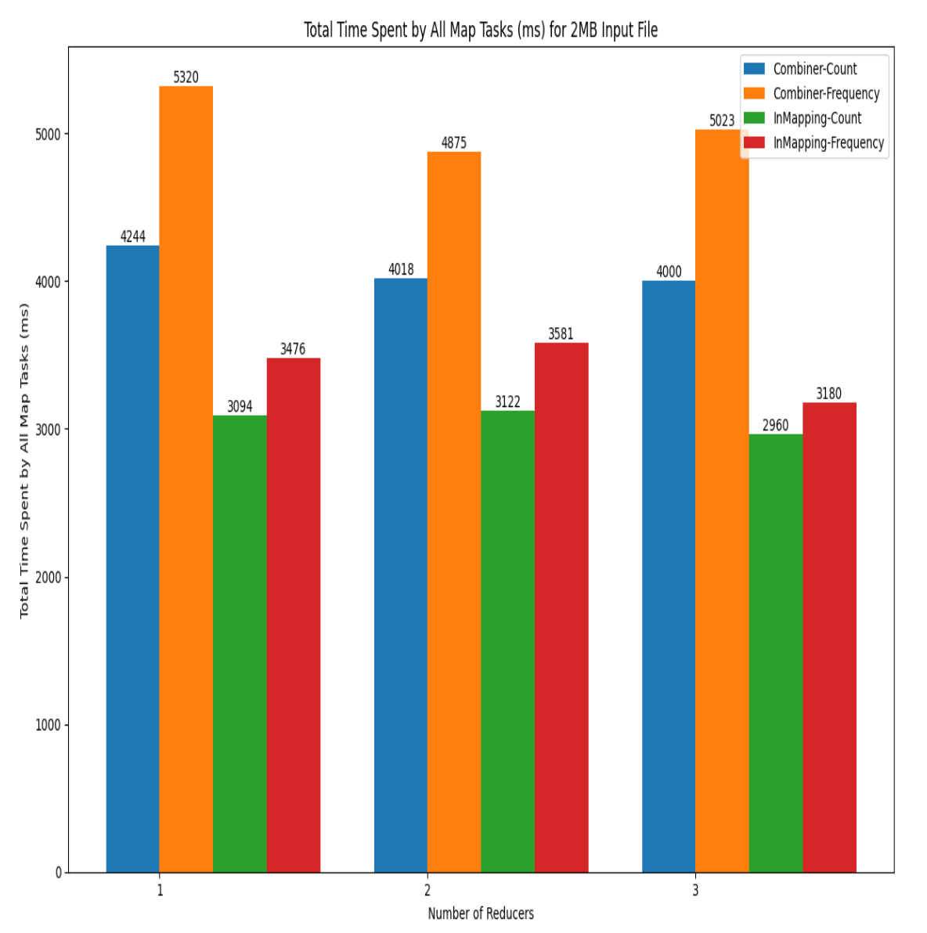
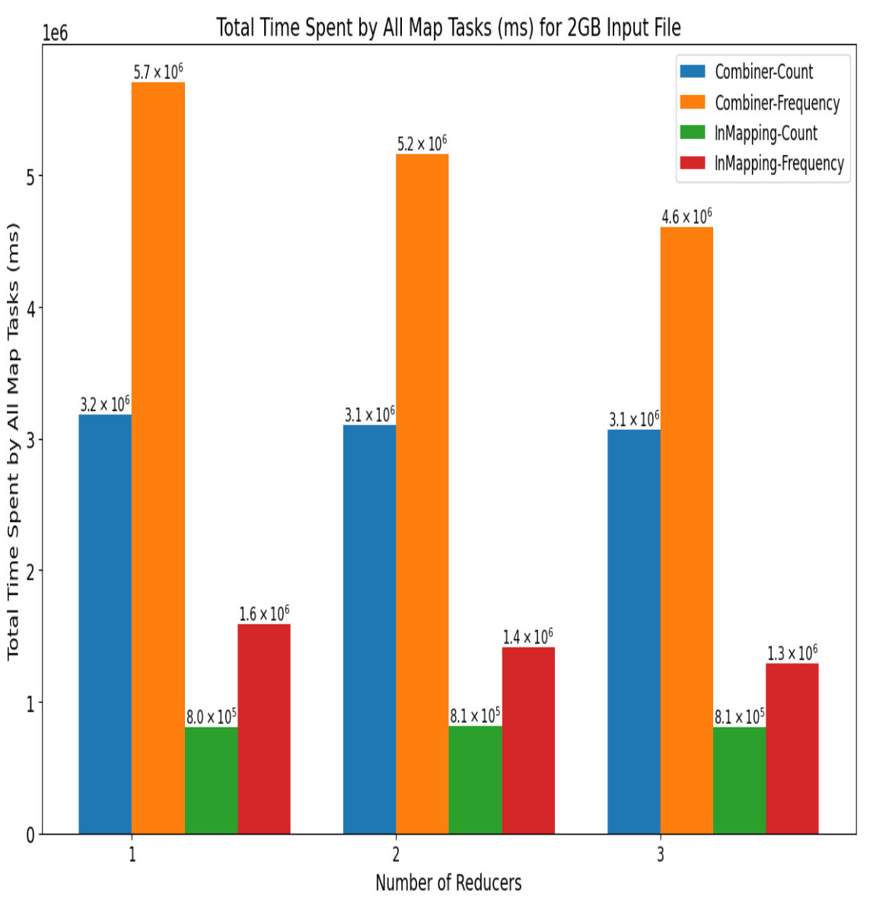
PERFORMANCE ANALYSIS
MAIN RESULTS

Slide 17
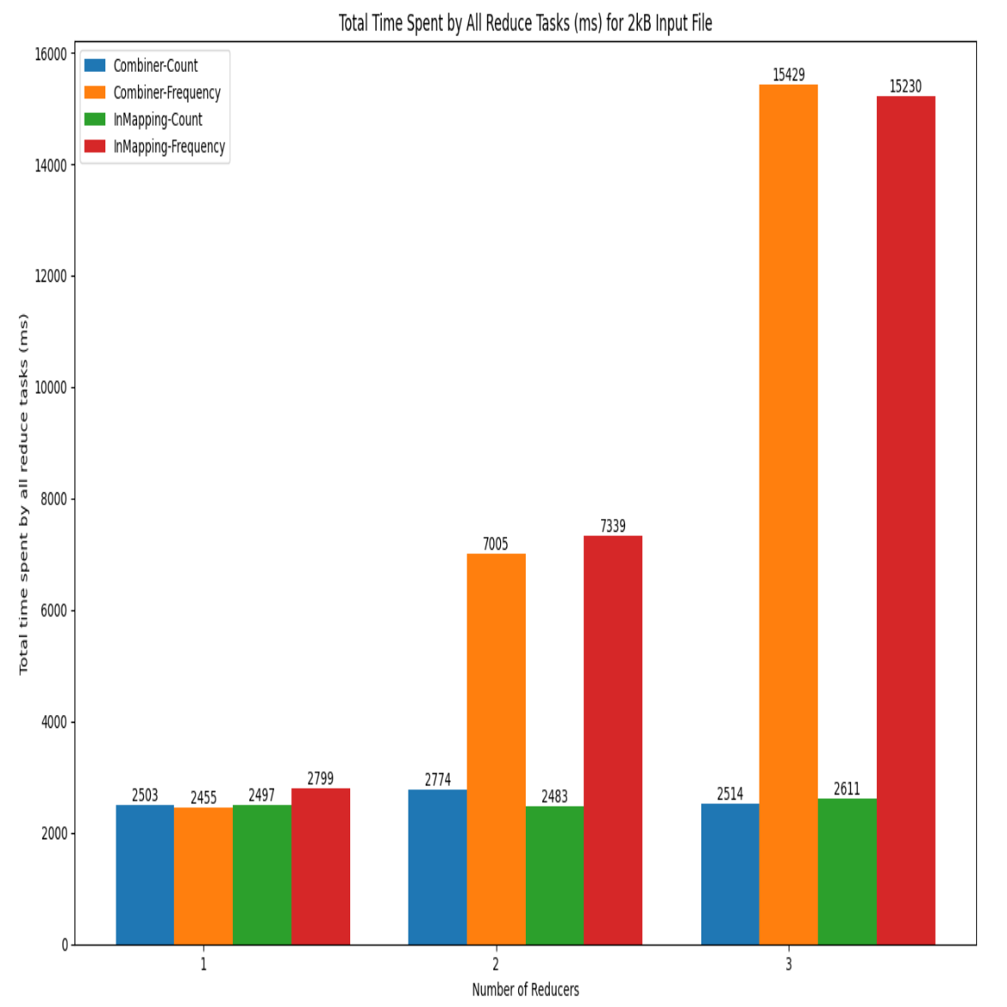
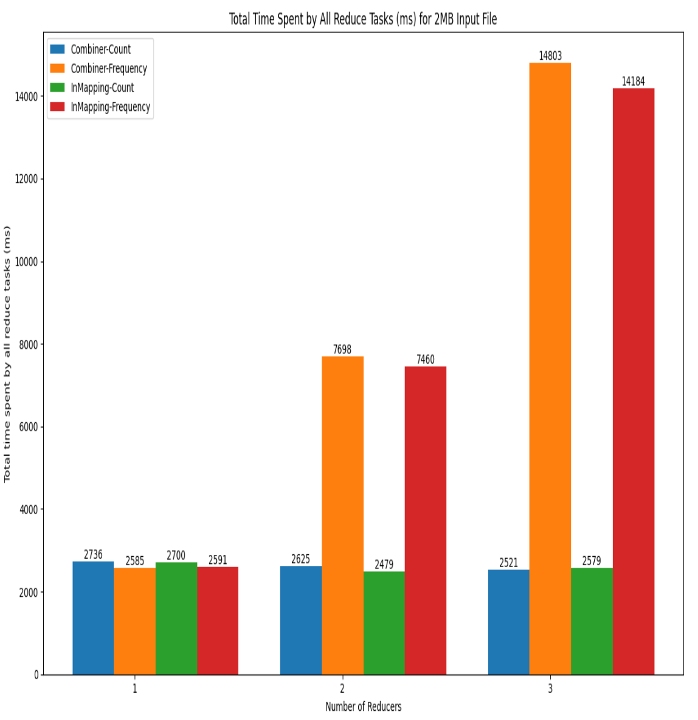
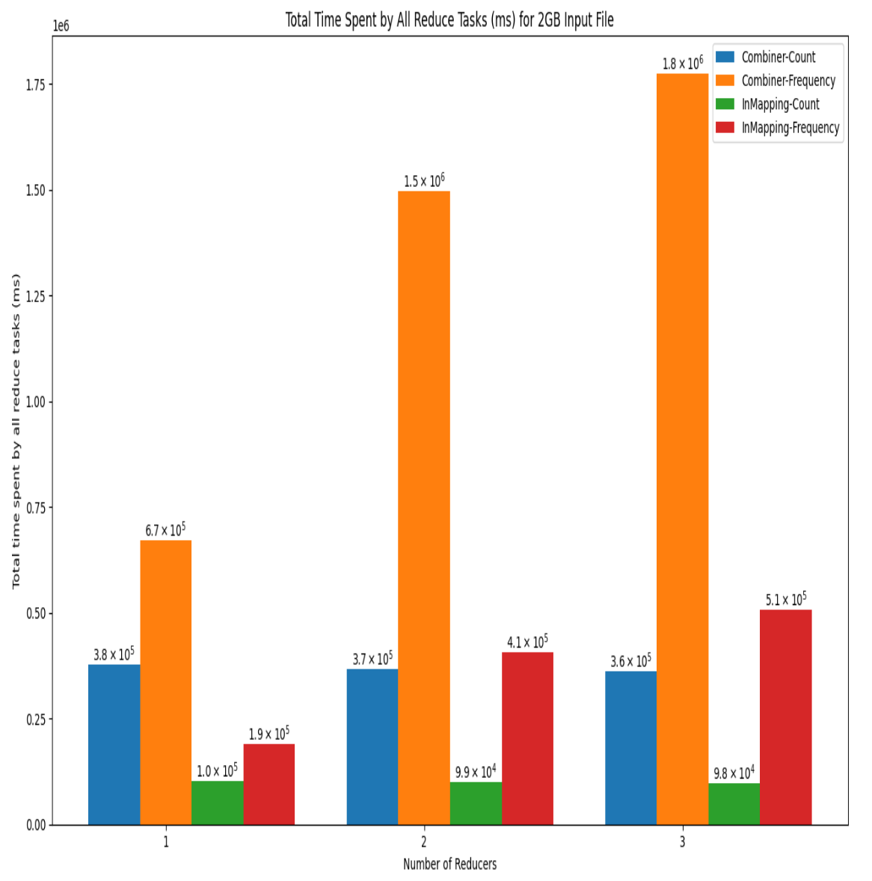
PERFORMANCE ANALYSIS
MAIN RESULTS

Slide 18
PERFORMANCE ANALYSIS
CONSIDERATIONS
BEST DESIGNS
NUMBER OF REDUCERS
COMBINER is better with little size input
INMAPPING COMBINING is better with large size input
1

Slide 19
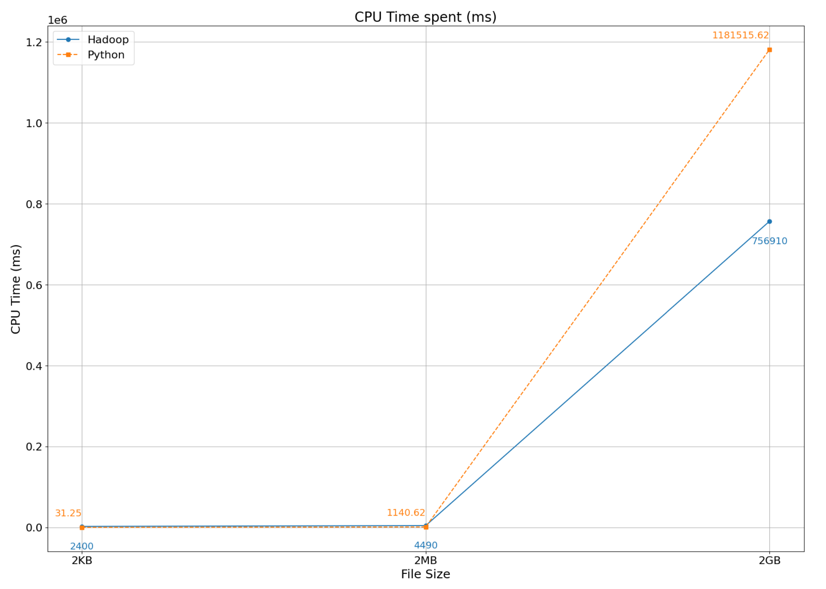
PERFORMANCE ANALYSIS
HADOOP VS PYTHON
PYTHON LOCAL EXECUTION
To do this comparison, we’ve used the same input files as before, and used CPU time spent as the benchmark.

Slide 20
STATISTIC ANALYSIS
NUMBER OF REDUCER
INPUT FILE.TXT
ALGHORITM
PINOCCHIO
COMBINER
1
(250 kb)

Slide 21
STATISTIC ANALYSIS
DIFFERENT LENGUAGES
FINNO-UGRIC
GERMANIC
ROMANCE
ITALIAN
FRENCH
PORTUGUESE
SPANISH
DUTCH
ENGLISH
GERMAN
FINNISH

Slide 22
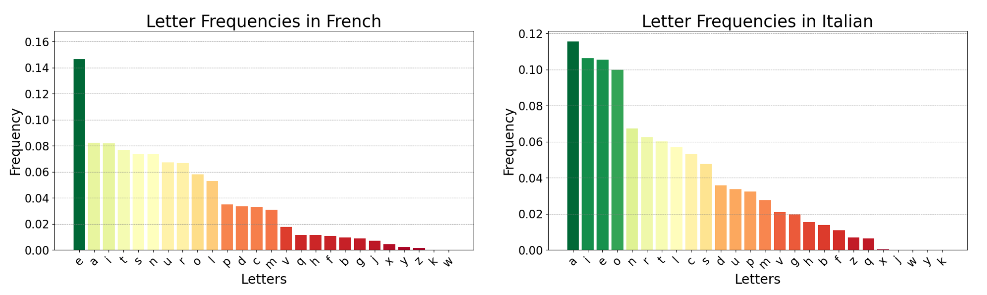
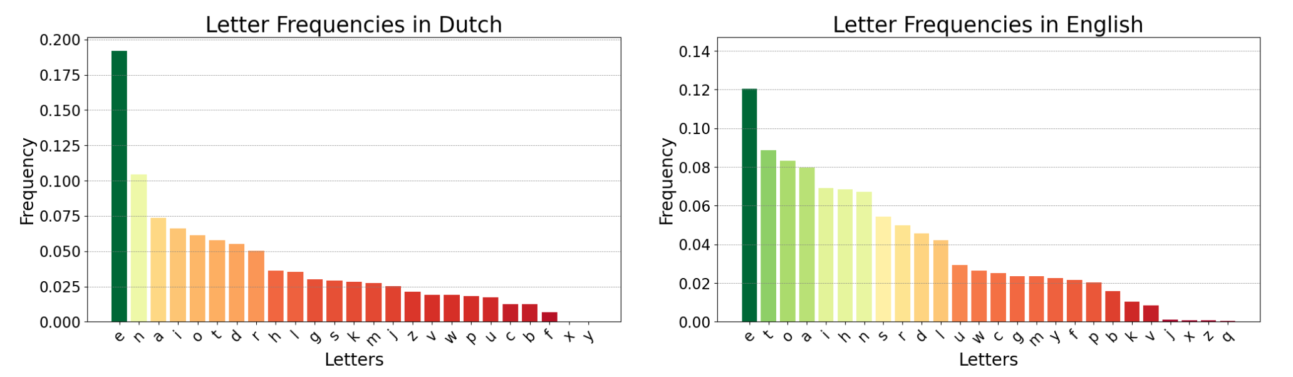
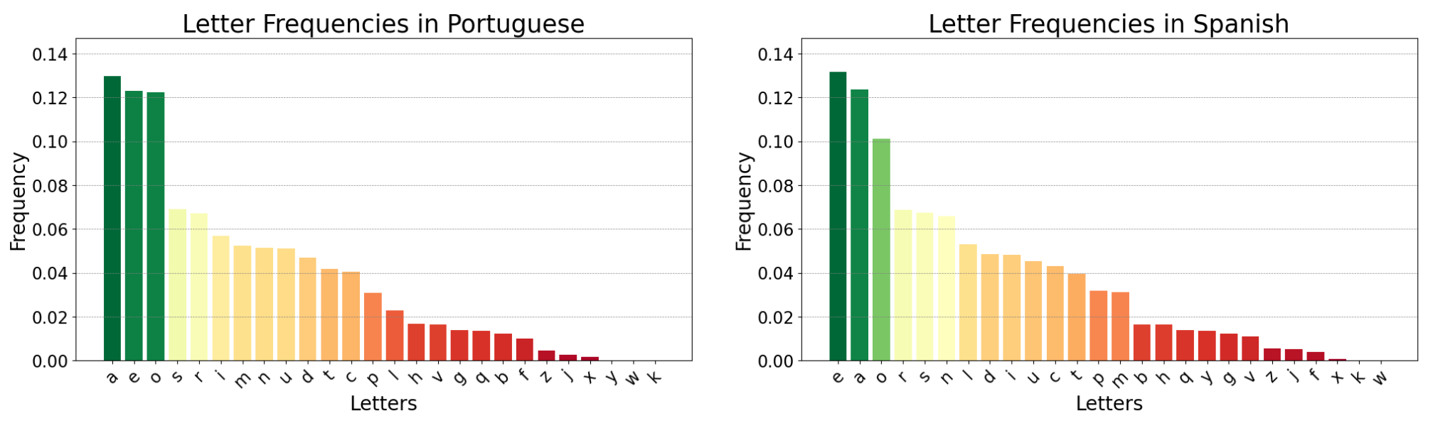
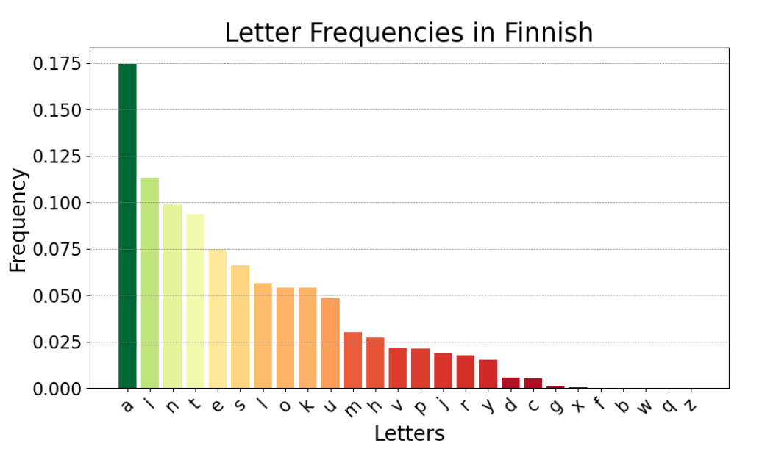
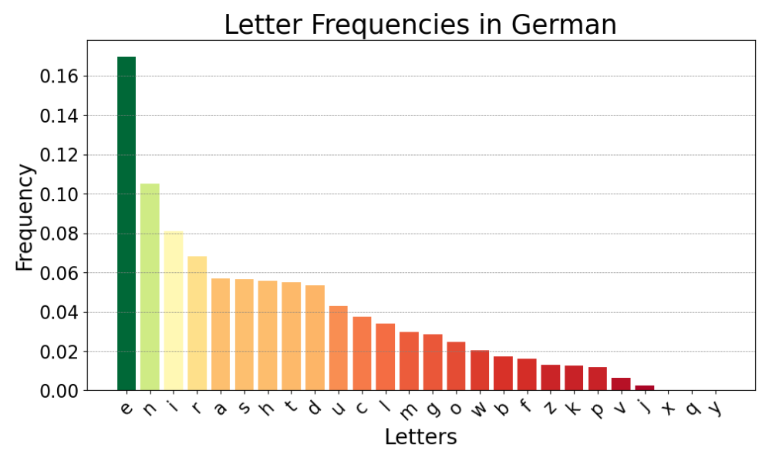
STATISTIC ANALYSIS
MAIN RESULTS

Slide 23
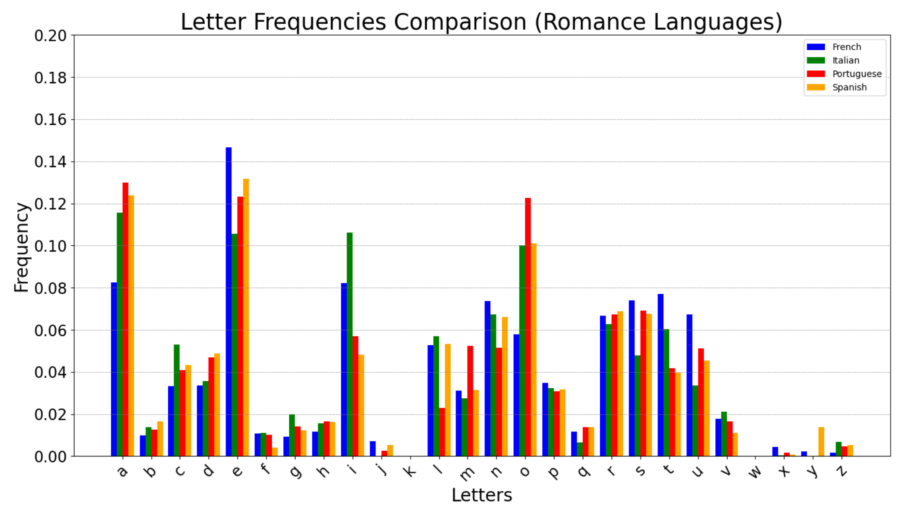
STATISTIC ANALYSIS
MAIN RESULTS

Slide 24
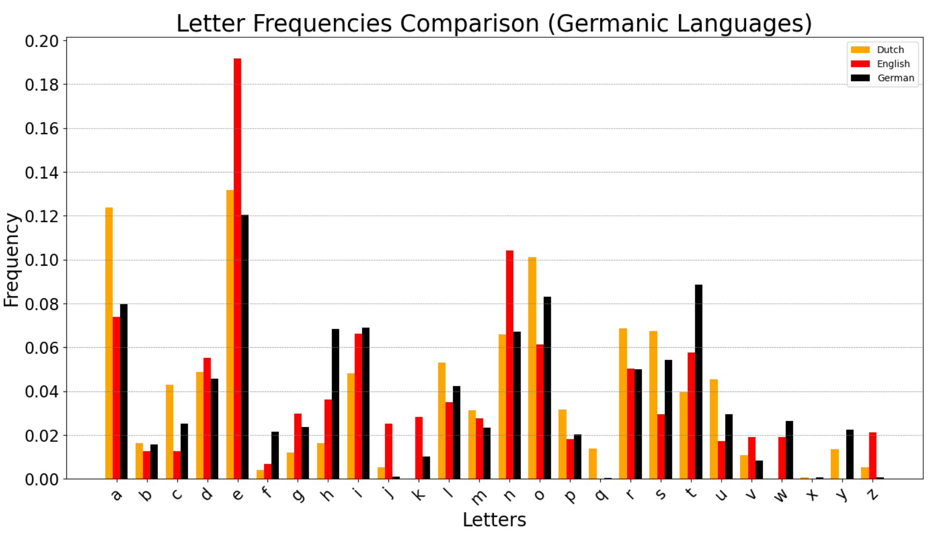
STATISTIC ANALYSIS
MAIN RESULTS

Slide 25

THANK YOU!
MARTINA FABIANI
ROSSANA ANTONELLA SACCO
TOMMASO FALASCHI

